Slide 1

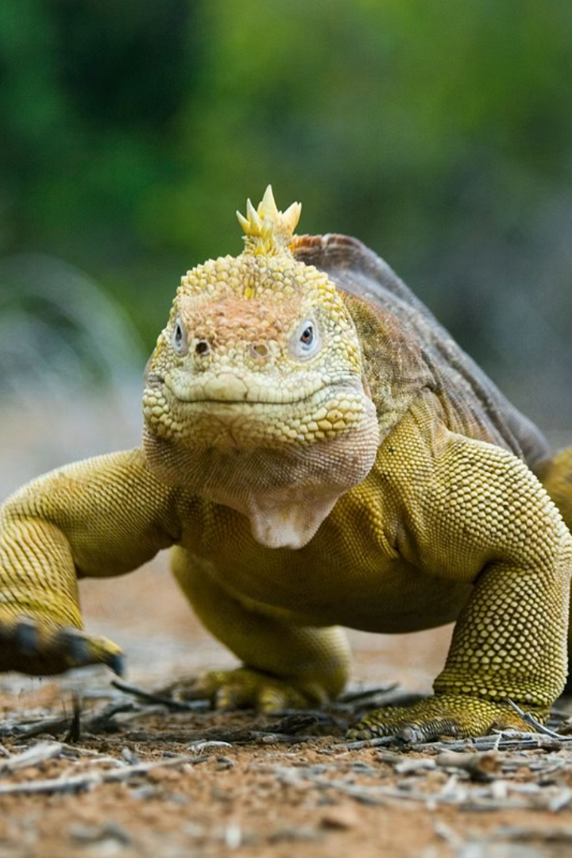

Residual Phylogenetic Diversity in Tetrapods
Tetrapods, the four-limbed vertebrates, exhibit a remarkable diversity in their evolutionary lineages. This presentation will explore the concept of residual phylogenetic diversity (PD) - the unique evolutionary history captured within tetrapod species and its importance for conservation and evolutionary biology.
Ha
by Hector Tejero

Slide 2
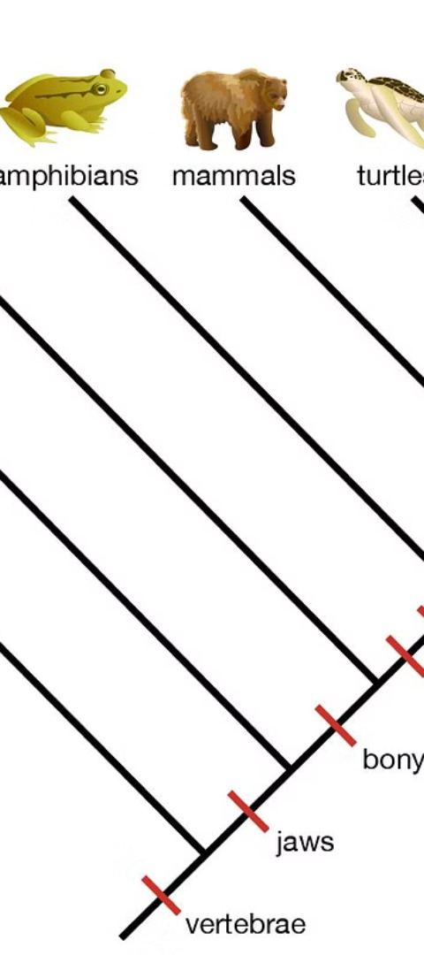
Defining Phylogenetic Diversity and Its Importance
1
Phylogenetic Diversity
2
Importance for Conservation
PD quantifies the evolutionary history and distinctness of species within a given group, capturing the unique genetic and phenotypic characteristics they possess.
Preserving PD is crucial for maintaining the evolutionary potential and adaptive capacity of tetrapod lineages in the face of environmental change and threats.
3
Evolutionary Insights
Analyzing patterns of residual PD can reveal the underlying drivers of diversification and adaptation within tetrapod clades.

Slide 3
Factors Influencing Residual PD in Tetrapods
Evolutionary History
Environmental Heterogeneity
Biogeography
The unique evolutionary trajectories of different tetrapod lineages, shaped by processes like speciation, extinction, and adaptive radiation.
The geographical distribution and isolation of tetrapod species, which can influence patterns of diversification and the accumulation of PD.
The diversity of habitats and ecological niches occupied by tetrapods, which can foster the emergence of unique adaptations.

Slide 4
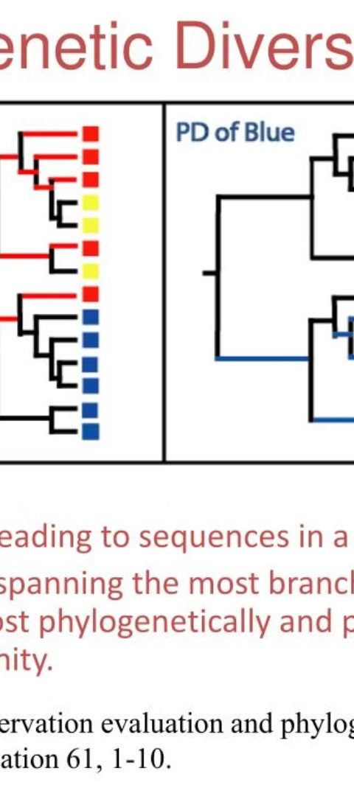
Methodological Approaches to Measuring Residual PD
1
Phylogenetic Trees
Constructing robust phylogenetic trees to represent the evolutionary relationships among tetrapod species.
2
Diversity Metrics
Calculating PD indices that quantify the evolutionary distinctness and uniqueness of species within a given tetrapod assemblage.
3
Comparative Analyses
Applying statistical methods to identify the factors driving patterns of residual PD across different tetrapod lineages.

Slide 5
Patterns of Residual PD Across Tetrapod Lineages
Amphibians
Reptiles
Birds and Mammals
Amphibians exhibit high levels of residual PD, with many ancient lineages and unique adaptations to diverse aquatic and terrestrial habitats.
Reptiles show variable patterns of residual PD, with some highly diverse clades like crocodilians and some island-dwelling lineages with low PD.
These tetrapod classes have experienced extensive diversification, with both hotspots of high residual PD and lineages with reduced PD.

Slide 6
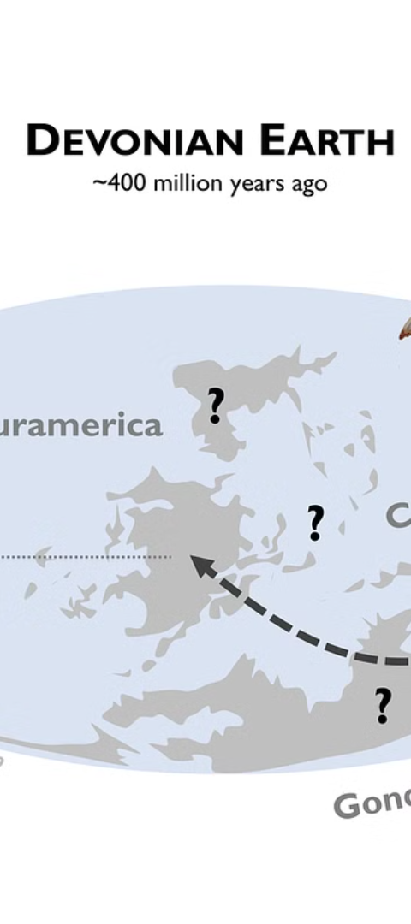



Drivers of Residual PD Variation in Tetrapods
Diversification Rates
Higher rates of speciation and lower rates of extinction can lead to the accumulation of residual PD within a tetrapod lineage.
Ecological Specialization
Adaptations to unique ecological niches can promote the evolution of distinct tetrapod lineages and increase residual PD.
Geographical Isolation
Isolation of tetrapod populations, such as on islands or in mountain ranges, can foster the emergence of endemic species with high residual PD.

Slide 7
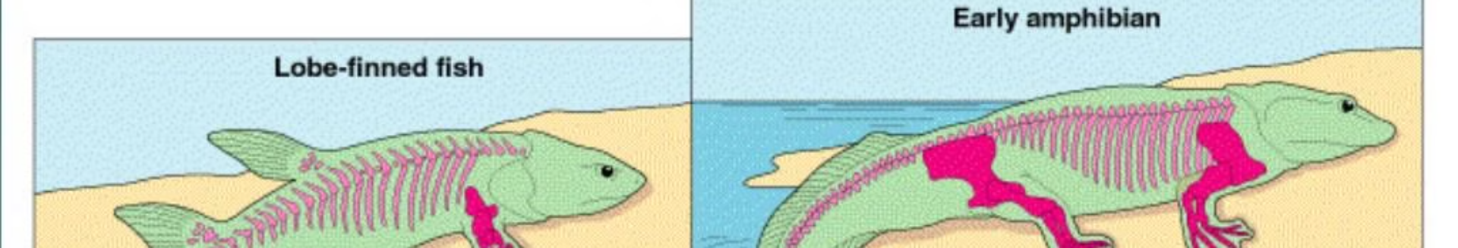
Implications for Conservation and Evolutionary Biology
Conservation Prioritization
Evolutionary Potential
Ecological Functions
Preserving tetrapod PD can help maintain the stability and resilience of ecosystems, as different lineages often fulfill unique ecological roles.
Identifying tetrapod lineages with high residual PD can inform conservation efforts to preserve the most evolutionarily unique and irreplaceable species.
Maintaining high levels of residual PD can enhance the adaptive capacity of tetrapod communities, allowing them to respond to environmental changes.

Slide 8



Concluding Remarks and Future Research Directions
Future Research
Conservation Implications
Evolutionary Insights
Continued exploration of the drivers and patterns of residual PD in tetrapods, integrating new genomic and ecological data.
Applying PD analyses to uncover the mechanisms underlying tetrapod diversification and adaptation across spatial and temporal scales.
Leveraging PD metrics to guide conservation strategies and protect the most evolutionarily distinct tetrapod species and lineages.

